Slide 1

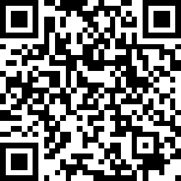
CS2113/T – Lecture 9
Download the L9-Exercises PDF from LumiNUS
Download the UML reference sheet
Have a imaging/scanning app ready on the phone.
Alternatively, you can use a tablet to draw
Submit PDF only
Also, join the session: http://pollev.com/anarayan
This lecture will be recorded
This lecture will be recorded
session
Archipelago
Disclaimer: There is a question on the last slide of the lecture today

Slide 2

Recap
Modeling: UML Structure diagrams (and drawing)
Design fundamentals
Abstraction, Coupling and Cohesion
Design principles
Error handling

Slide 3
Q: Increasing coupling …………………. testability
Increases
Decreases (ans)
Doesn’t affect

Slide 4
(a)
(b)
(c)
A
B
A
A
C
(d)
B
C
:B
(e)
(f)
(g)
:B
:C
:A
A
B
:B
:C

Slide 5
Q: This is the correct way to represent for loop in sequence diagram
:A
:B
A: False
for
[4 times]
goo()
foo()

Slide 6
UI
Sequence Diagrams
[interactions between components for a given scenario]

Slide 7
alt
[condition 1]
name:ClassName
<<class>>
:ClassName
classLevelMethod()
[condition 2]
[else]
create
:Class2Name
opt
[condition]
message/method
self-invocation
loop
[condition]
return value
X
Activation bar
par
Life line

Slide 8
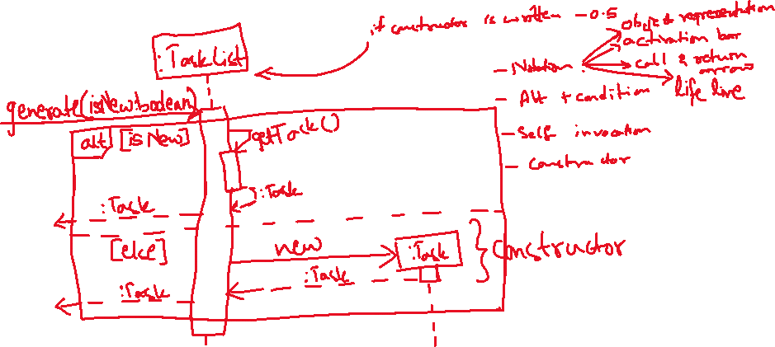
Q: Draw a suitable UML Diagram to illustrate the interaction caused by calling the generate method below.
class Tasklist {
Task generate(boolean isNew) {
if (isNew) {
return getTask();
} else {
return new Task();
}
}
...
}
Note: The solution drawn in the lecture was erased when PPT crashed ☹ There may be minor variation in this version!

Slide 9
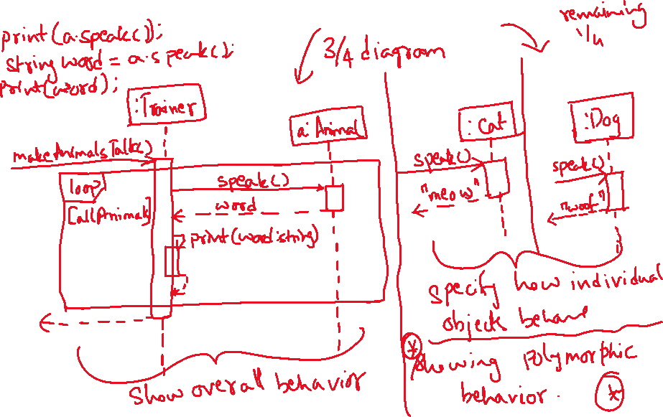
Q: Draw the sequence diagram to illustrate the interaction caused by calling makeAnimalsTalk method.
abstract class Animal {
public abstract String speak ();
}
[No need to have such complicated UML diagrams in your DG]
Note: The solution drawn in the lecture was erased when PPT crashed ☹ There may be minor variation in this version!
class Dog extends Animal {
...
public String speak() {
return "woof";
}
}
class Cat extends Animal {
...
public String speak() {
return "meow";
}
}
class Trainer {
static Animal[] animals = {
new Dog(),
new Cat()
};
void makeAnimalsTalk() {
for (Animal a : animals) {
print(a.speak());
}
}
}
. . .
Missed in the handout

Slide 10
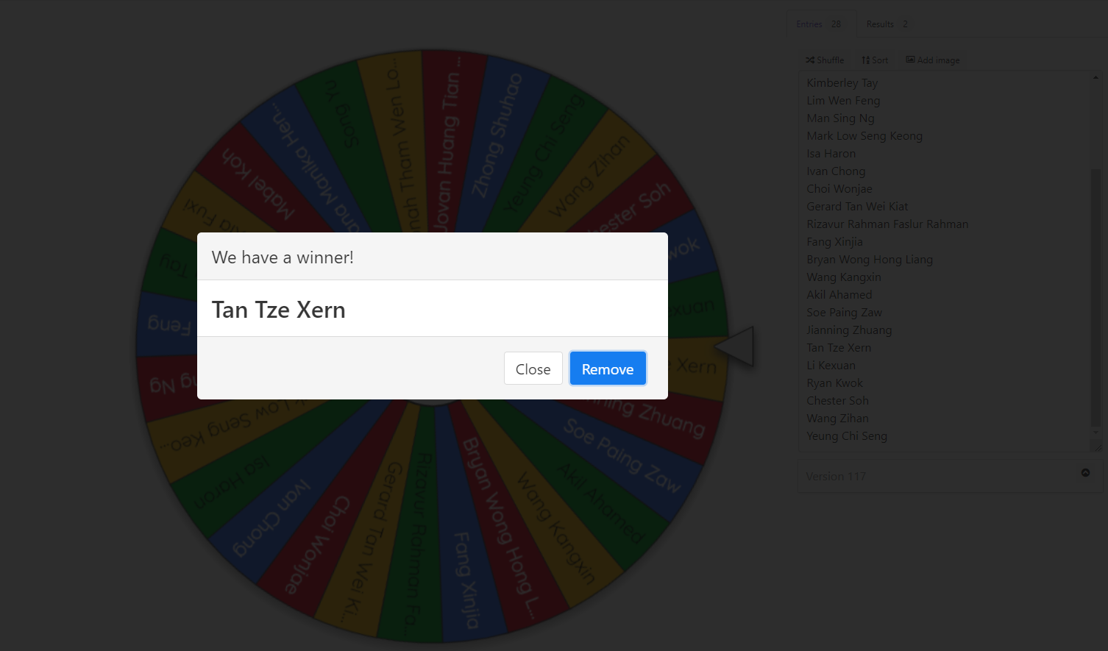
Spin the wheel!

Slide 11
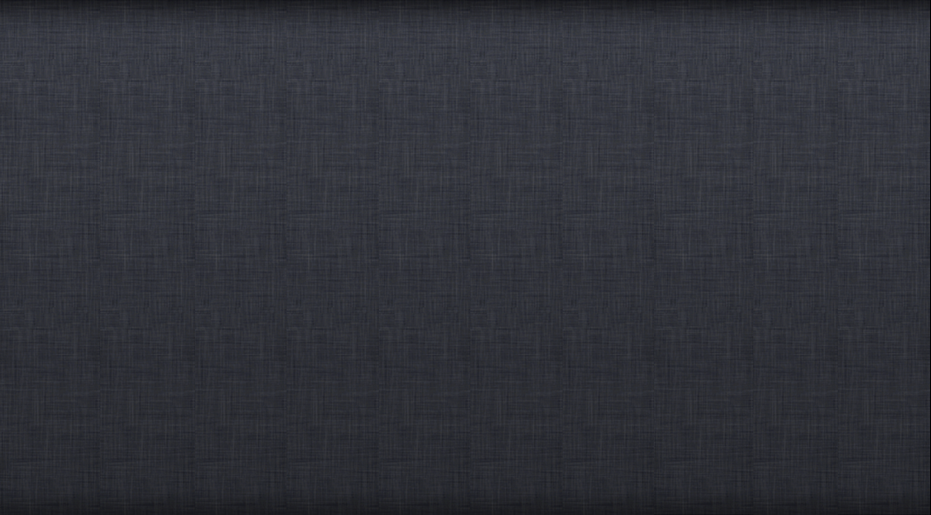
I/O testing
JUnit testing
← How much of this is being tested?
Product

Slide 12
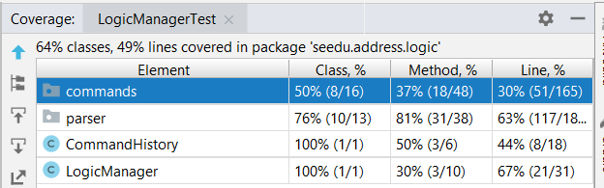
Can use coverage tool provided by IntelliJ
Can also use service providers like Coveralls
I/O testing
JUnit testing
← How much of this is being tested?

Slide 13
Demo: IntelliJ built-in Coverage tool
Enable branch coverage via tracing
Run -> Edit configuration -> Code coverage -> select Tracing
Run test with coverage
Observe the method coverage for StringParserTest
Add new test for the added method and check method and branch coverage now.

Slide 14
I/O testing
JUnit testing
← How much of this is being tested?
Path coverage
Path coverage
Exit/entry coverage
Branch coverage
Statement coverage
Statement coverage
Function coverage
Condition coverage

Slide 15
I/O testing
JUnit testing
← How much of this is being tested?
Path coverage
void readInput(){
while ( hasInput() )
input += readFromKeyboard();
}
Statement coverage

Slide 16
I/O testing
JUnit testing
← How much of this is being tested?
void readInput(){
while ( hasInput() )
input += readFromKeyboard();
}
Statement coverage

Slide 17
I/O testing
JUnit testing
← How much of this is being tested?
Path coverage
void readInput(){
while ( hasInput() )
input += readFromKeyboard();
}

Slide 18
I/O testing
JUnit testing
← How much of this is being tested?
Path coverage
void readInput(){
while ( hasInput() )
input += readFromKeyboard();
}

Slide 19
I/O testing
JUnit testing
← How much of this is being tested?
Path coverage
void readInput(){
while ( hasInput() )
input += readFromKeyboard();
}

Slide 20
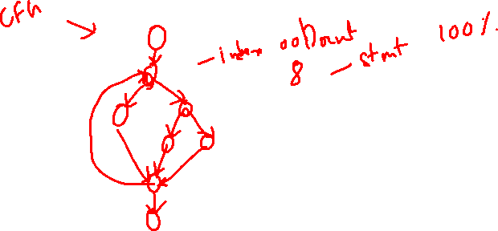
I/O testing
JUnit testing
← How much of this is being tested?
Path coverage
void readInput(){
while ( hasInput() )
input += readFromKeyboard();
}
void readInput(){
while ( hasInput() )
input += readFromKeyboard();
}

Slide 21
I/O testing
JUnit testing
← How much of this is being tested?
Path coverage
Exit/entry coverage
Branch coverage
Statement coverage
Function coverage
Condition coverage

Slide 22
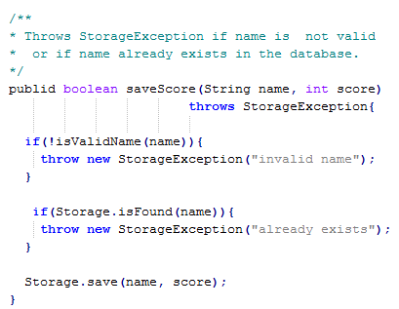
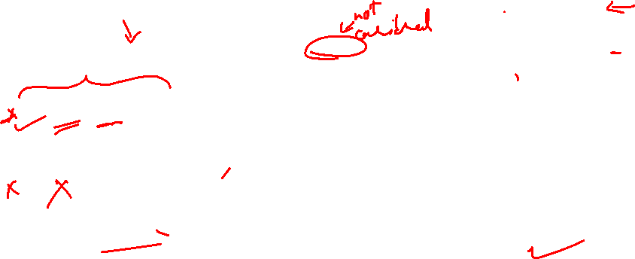
Q. Estimate the statement coverage of this method for these three test cases.
Test input | Expected
“new guy”, 0 | success
null , -3 | Name invalid -> exception
“”, 5 | Name invalid -> exception
public
1
2
3
0%
50%
80%
100%
4
5

